Slide 1

DELL PROJECT
SERVER SIDE + DB
Lina,Sally, Marshod, Salih, Rami and Yousef

Slide 2
User and session management
Login
Session management
Forgot password
Profile
User list
Create user
Update user
Delete user
* Mahran
* Abdalla
* Sizar
* Mahmoud

Slide 3
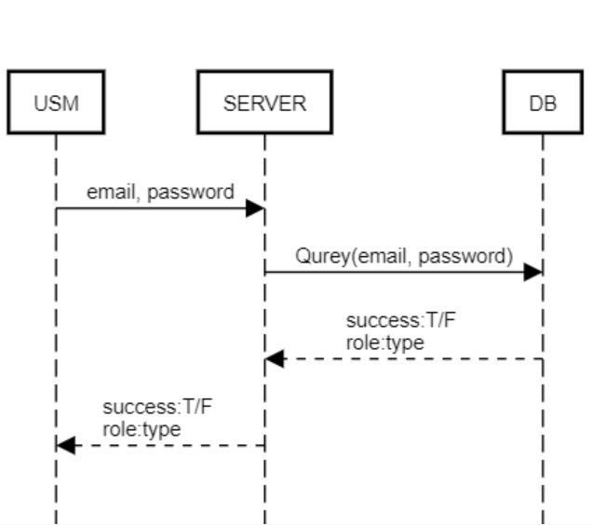
LogIn:
REST API: ‘/api/ users/ login’
fetch=> POST

Slide 4
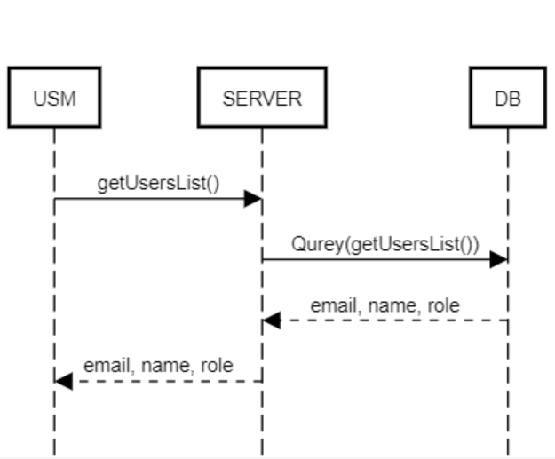
Admin page
Rest API: '/api/ users/ getUsersList’
fetch=>GET

Slide 5
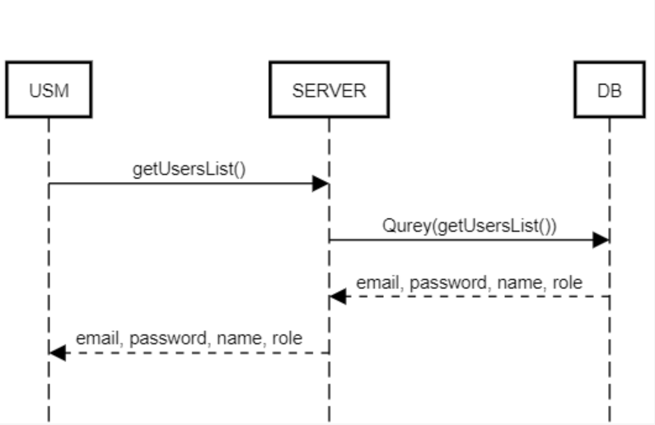
Show profile:
REST: ‘/api/ users/ getUserInfo’
fetch=>POST

Slide 6
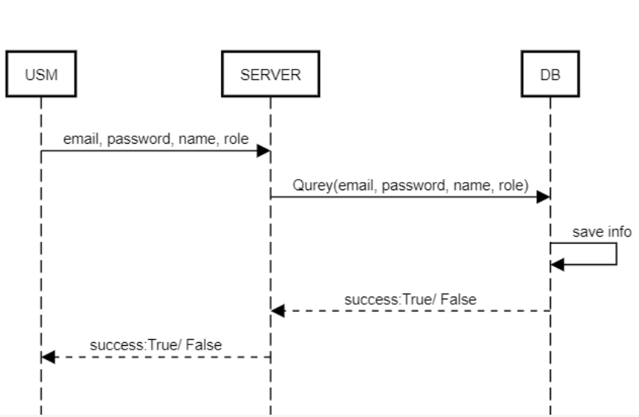
Create user:
REST: ‘/api/users/createUser’
fetch => POST

Slide 7
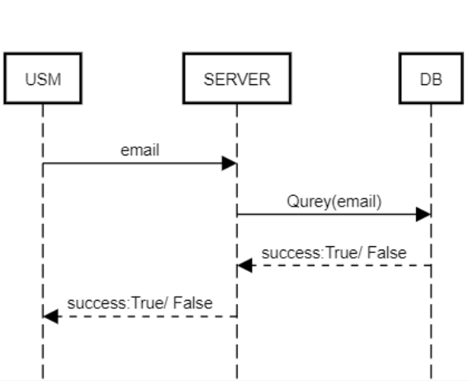
Delete user:
REST: ‘/api/ users/ deleteUser’
fetch => DELETE

Slide 8
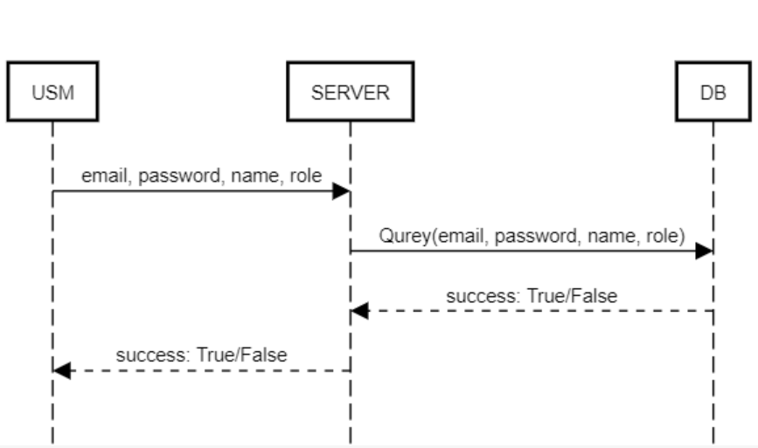
Edit user:
REST: ‘/api/ users/ editUser’
fetch => UPDATE

Slide 9
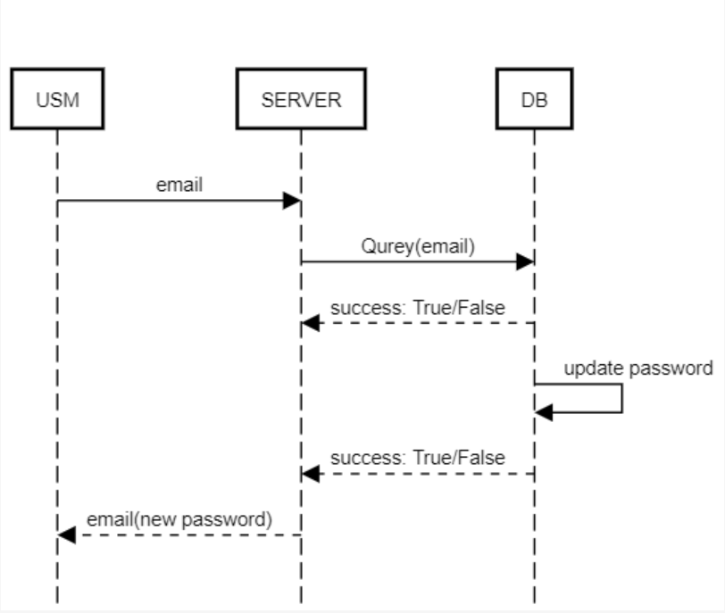
Forgot password:
REST: ‘/api/ users/ forgotPassword’
fetch => POST

Slide 10
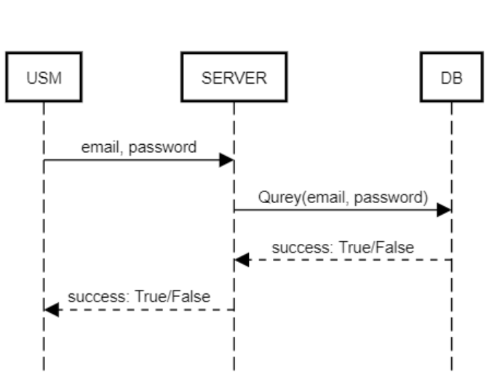
Check sended password:
REST: ‘/api/ users/ checkSendedPassword’
fetch => POST

Slide 11
Update password:
REST: ‘/api/ users/ updatePassword’
fetch => UPDATE

